Slide 1
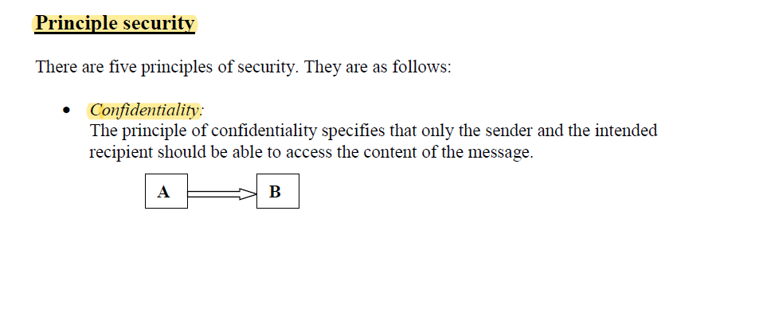
Last week

Slide 2
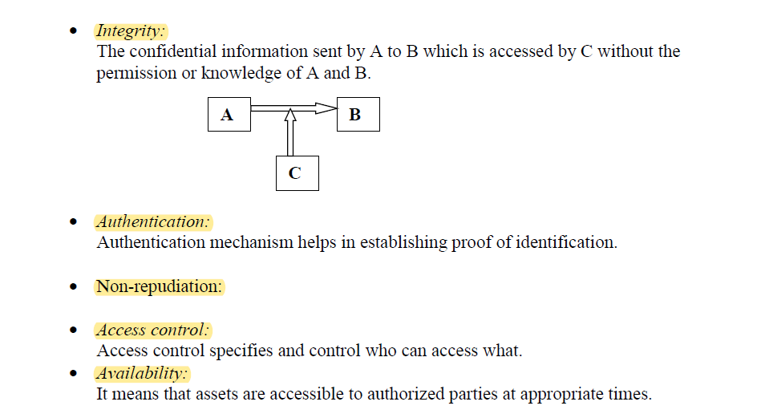
Last week

Slide 3
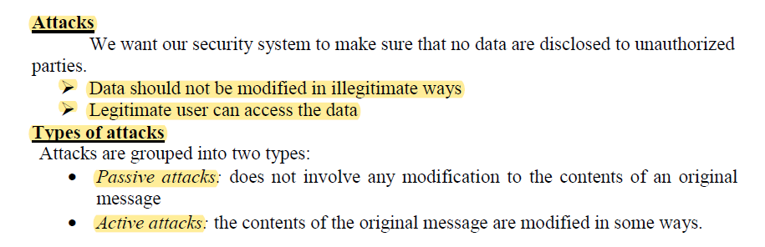
Last week

Slide 4
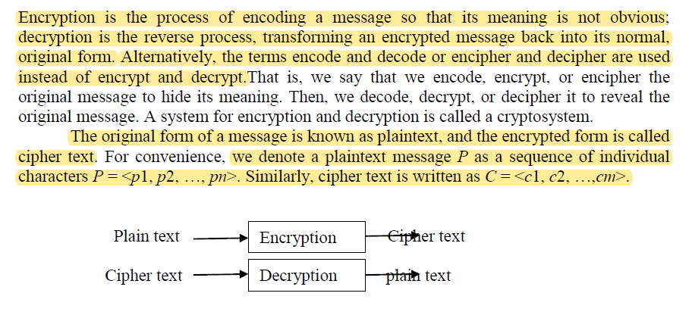
ELEMENTARY CRYPTOGRAPHY

Slide 5
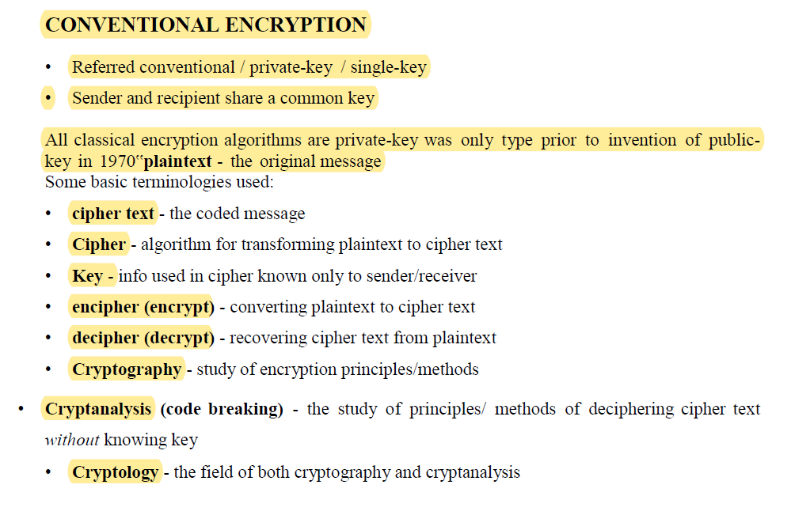
ELEMENTARY CRYPTOGRAPHY

Slide 6
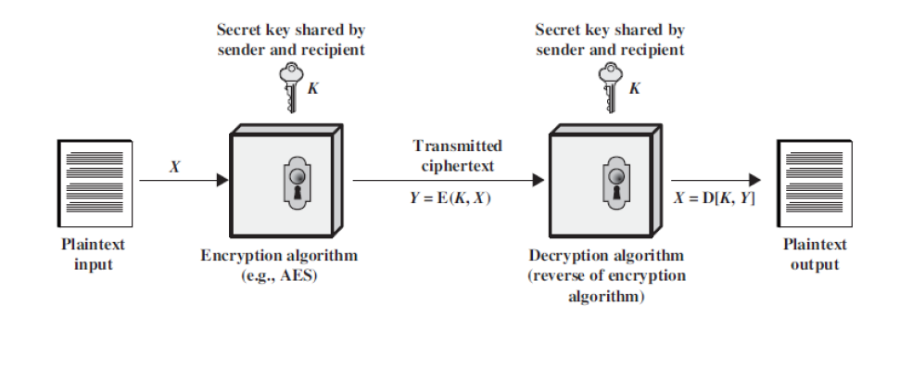
ELEMENTARY CRYPTOGRAPHY

Slide 7
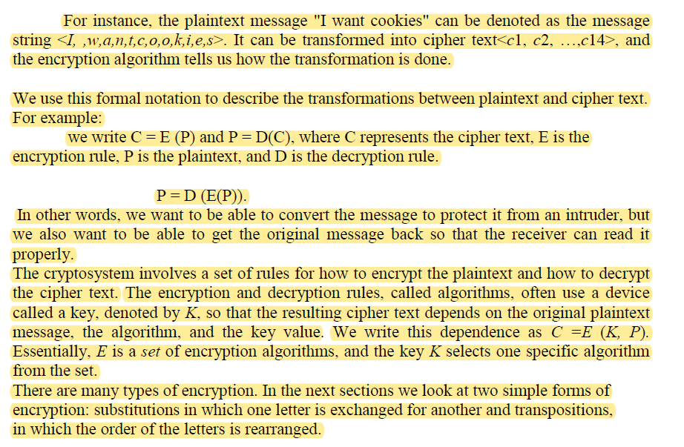
ELEMENTARY CRYPTOGRAPHY

Slide 8
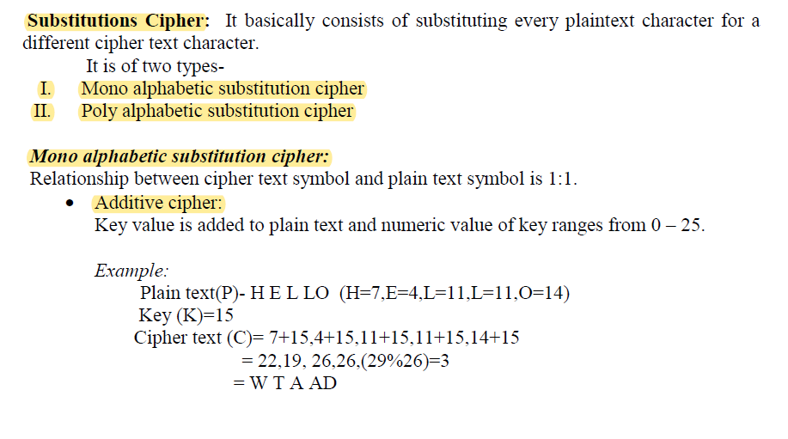
ELEMENTARY CRYPTOGRAPHY

Slide 9
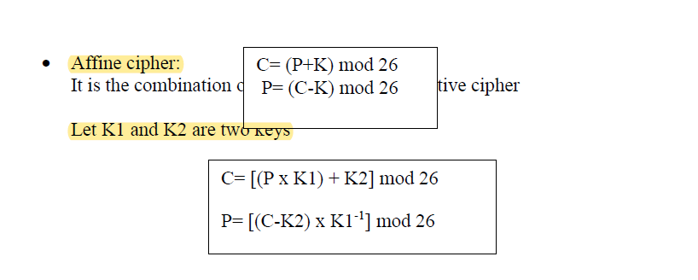
ELEMENTARY CRYPTOGRAPHY

Slide 10
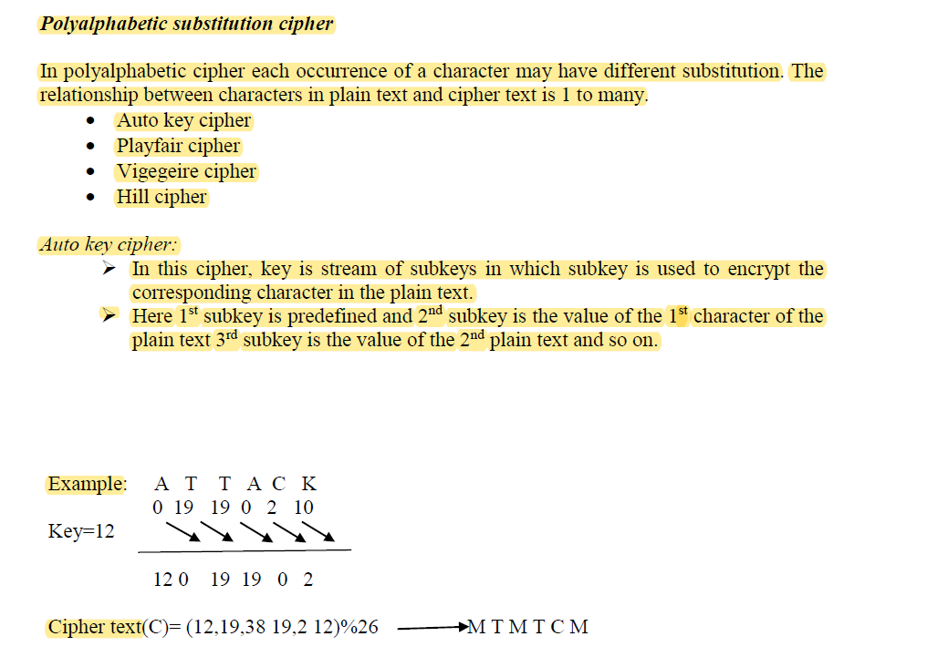
ELEMENTARY CRYPTOGRAPHY

Slide 11
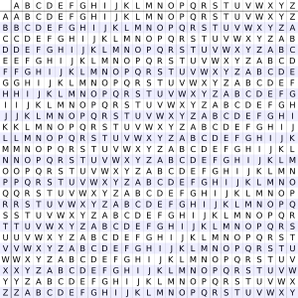
ELEMENTARY CRYPTOGRAPHY
TYPES OF AUTOKEY CHIPER
There are two forms of autokey cipher: key-autokey and text-autokey ciphers. A key-autokey cipher uses previous members of the keystream to determine the next element in the keystream. A text-autokey uses the previous message text to determine the next element in the keystream.
More popular autokeys use a tabula recta, a square with 26 copies of the alphabet, the first line starting with 'A', the next line starting with 'B' etc. Instead of a single letter, a short agreed-upon keyword is used, and the key is generated by writing down the primer and then the rest of the message, as in Vigenère's version.
To encrypt a plaintext, the row with the first letter of the message and the column with the first letter of the key are located. The letter in which the row and the column cross is the ciphertext letter.
https://en.wikipedia.org/wiki/Autokey_cipher

Slide 12
ELEMENTARY CRYPTOGRAPHY
TYPES OF AUTOKEY CHIPER
Method
The autokey cipher, as used by members of the American Cryptogram Association, starts with a relatively-short keyword, the primer, and appends the message to it.
For example, if the keyword is QUEENLY and
the message is attack at dawn,
then the key would be QUEENLYATTACKATDAWN
Plaintext: attackatdawn
Key: QUEENLYATTACKATDAWN
Ciphertext: QNXEPVYTWTWP
The ciphertext message would thus be "QNXEPVYTWTWP".
https://en.wikipedia.org/wiki/Autokey_cipher

Slide 13
ELEMENTARY CRYPTOGRAPHY
To decrypt the message, the recipient would start by writing down the agreed-upon keyword.
QNXEPVYTWTWP
QUEENLY
The first letter of the key, Q, would then be taken, and that row would be found in a tabula recta.
That column for the first letter of the ciphertext would be looked across, also Q in this case, and the letter to the top would be retrieved, A.
Now, that letter would be added to the end of the key:
QNXEPVYTWTWP
QUEENLYA
a
TYPES OF AUTOKEY CHIPER
https://en.wikipedia.org/wiki/Autokey_cipher

Slide 14
ELEMENTARY CRYPTOGRAPHY
Then, since the next letter in the key is U and the next letter in the ciphertext is N, the U row is looked across to find the N to retrieve T:
QNXEPVYTWTWP
QUEENLYAT
At
That continues until the entire key is reconstructed, when the primer can be removed from the start.
With Vigenère's autokey cipher, a single mistake in encryption renders the rest of the message unintelligible
TYPES OF AUTOKEY CHIPER
https://en.wikipedia.org/wiki/Autokey_cipher

Slide 15
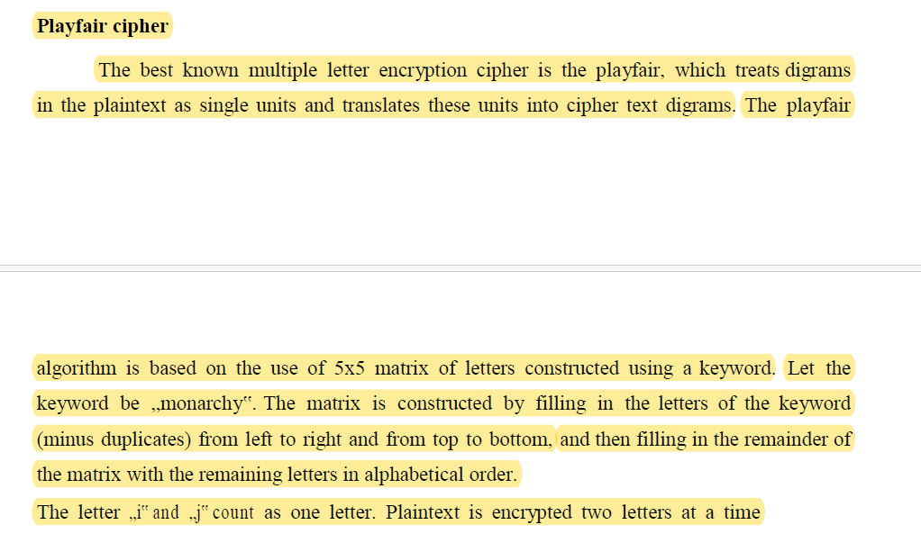
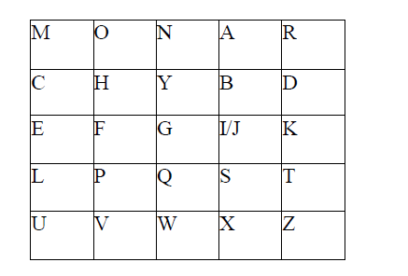
ELEMENTARY CRYPTOGRAPHY

Slide 16
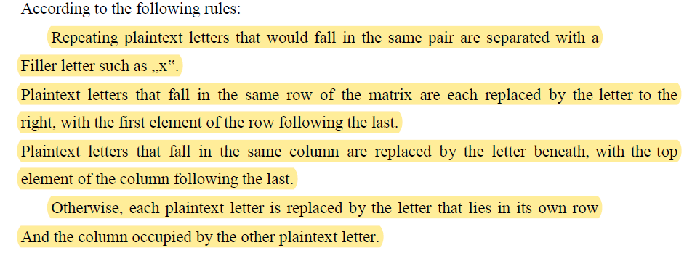
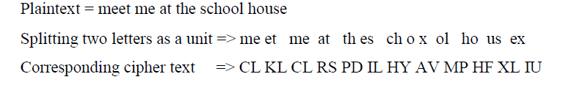
ELEMENTARY CRYPTOGRAPHY

Slide 17
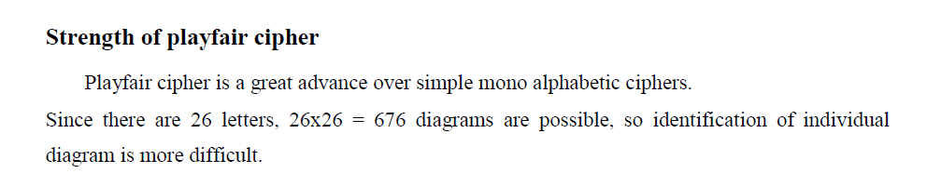
ELEMENTARY CRYPTOGRAPHY

Slide 18
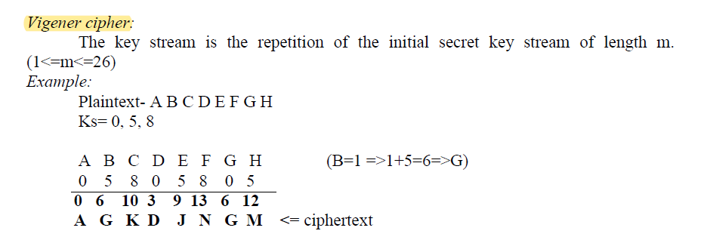
ELEMENTARY CRYPTOGRAPHY

Slide 19
ELEMENTARY CRYPTOGRAPHY

Slide 20
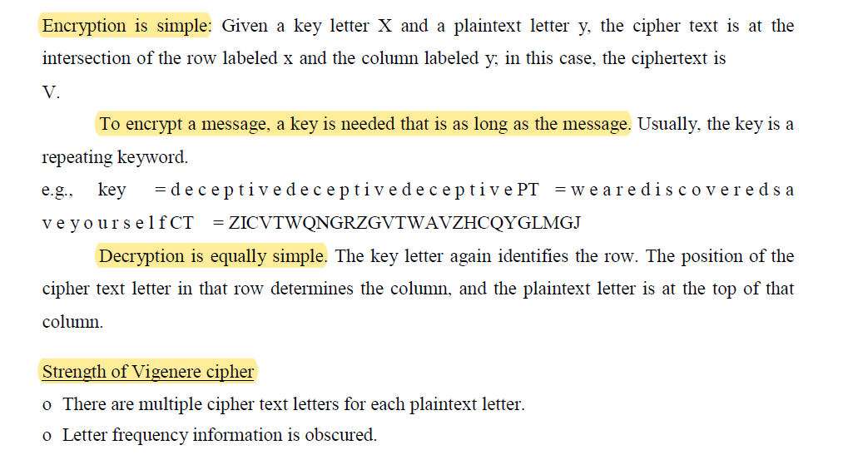
ELEMENTARY CRYPTOGRAPHY
TYPES OF Vigenère's CHIPER

Slide 21
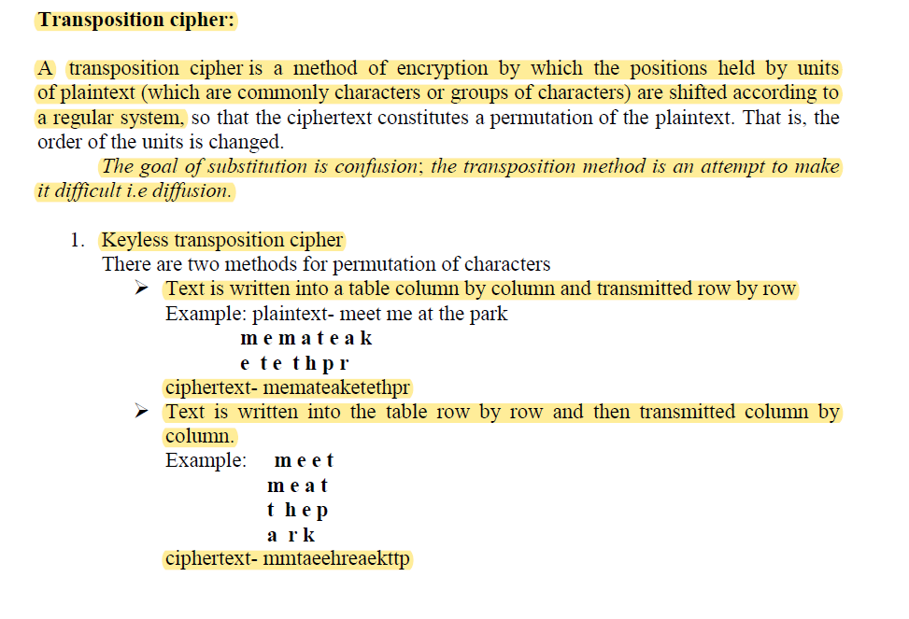
ELEMENTARY CRYPTOGRAPHY

Slide 22
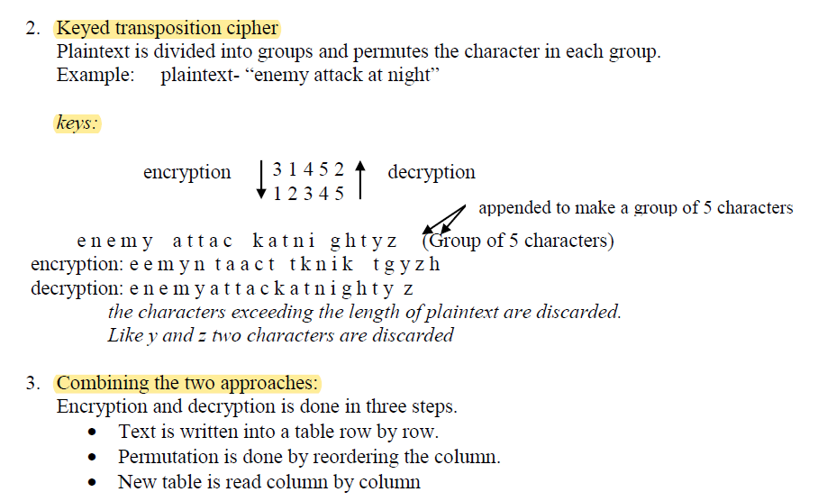
ELEMENTARY CRYPTOGRAPHY

Slide 23
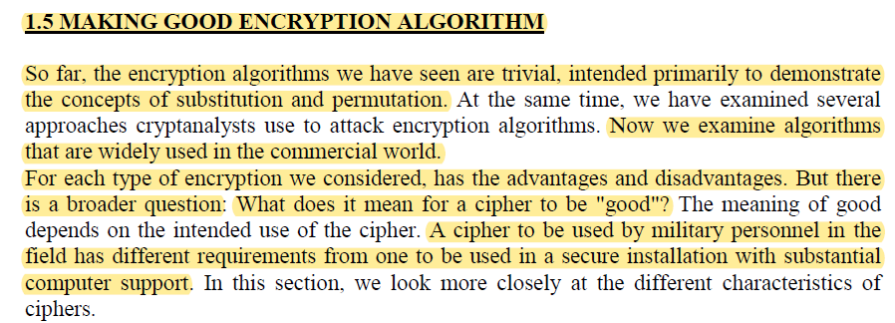

Slide 24
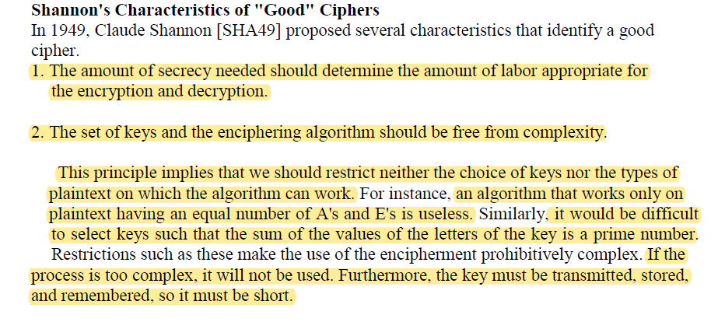

Slide 25
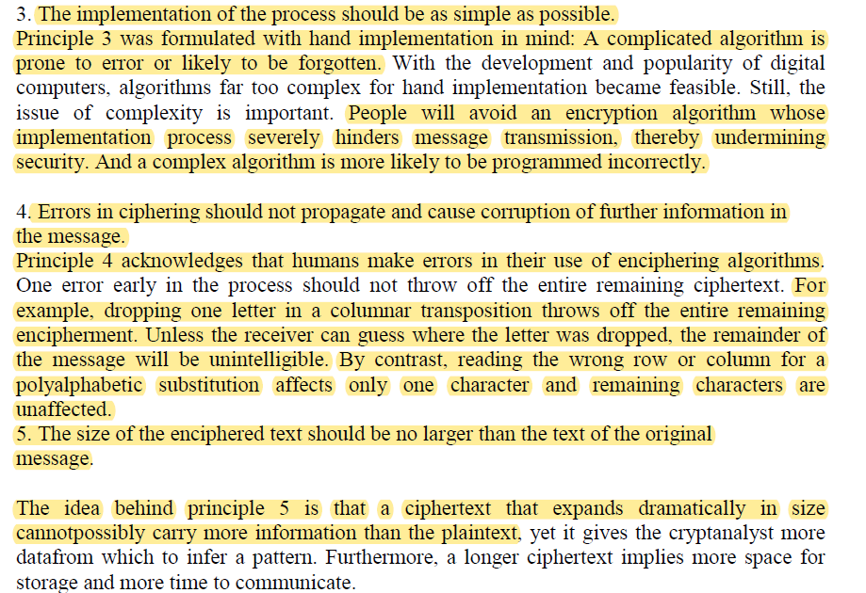

Slide 26
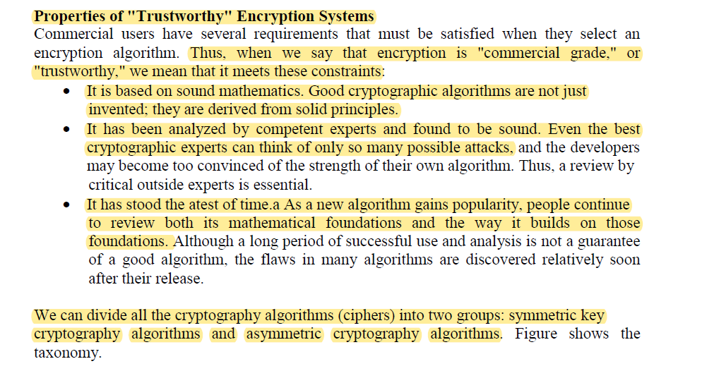

Slide 27
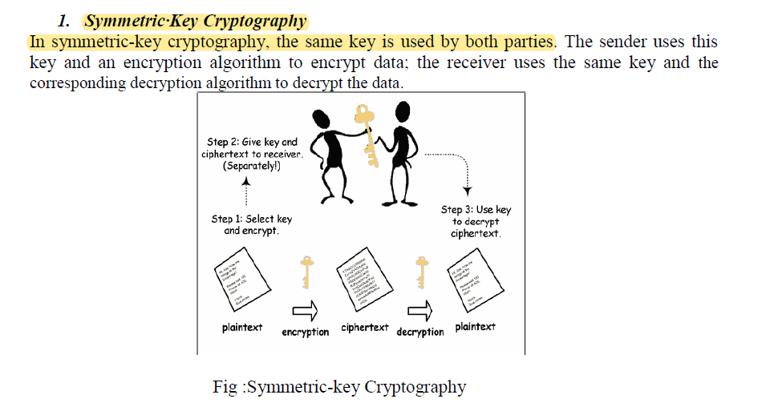

Slide 28
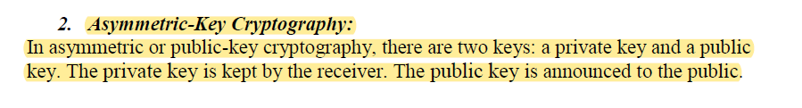
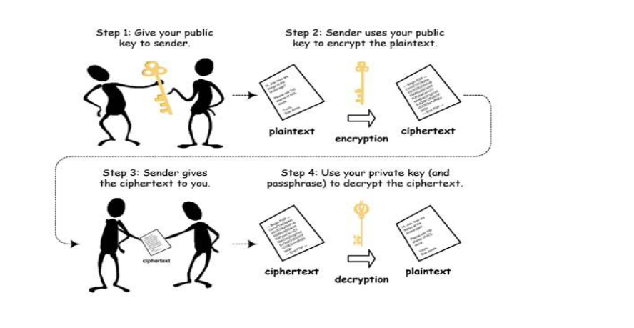

Slide 29
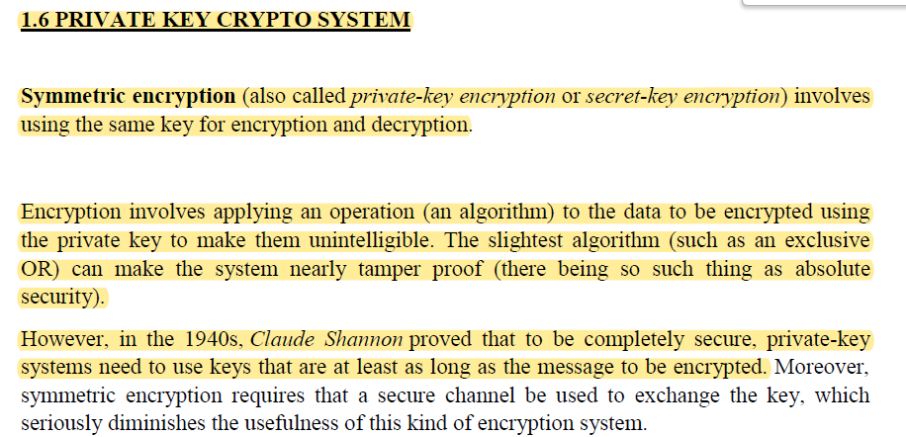

Slide 30
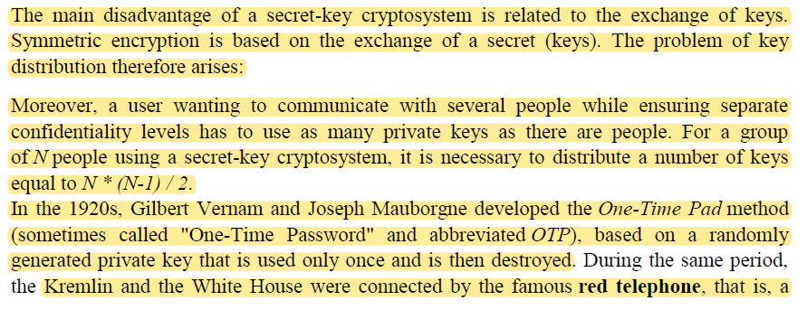
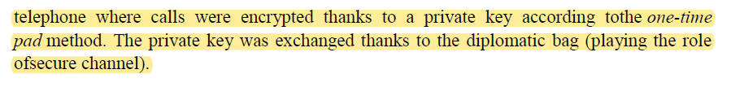

Slide 31
